Slide 1
CIMAT: A Compute-In-Memory Architecture For On-chip Training Based on Transpose SRAM Arrays
Author : Hongwu Jiang , Xiaochen Peng , Shanshi Huang , and Shimeng Yu , Senior Member
Published in: IEEE Transactions on Computers ( Volume: 69, Issue: 7, July 1 2020)
109598061 廖昱翔
Report Member : 109598061 吳承岳

Slide 2
Table of Contents
Introduction
Background : DNN Training & Compute-in-Memory
Hardware Support : 7T, 8T transpose SRAM bit cell design & Periphery Circuit
CIMAT architecture : FF, BP, Weight Gradient, Weight Update
Pipeline Design : 7T & 8T SRAM Bit-Cell-Based Pipeline Design
Experiments Setup, Circuit-Level Parameter
Notes:
There are four major concepts in this paper.
7T, 8T transpose SRAM bit cell design.
Periphery Circuit.
CIMAT architecture.
Pipeline optimization.
But Before understanding these, we have to know what DNN and CIM they are.
And We can find who the higher performance has through data analysis.

Slide 3
Reported By 109598061 廖昱翔

Slide 4
Introduction
To increase depth and size so that the accuracy is raised of DNNs,
need to large computational resource and memory storage for high-precision MAC operation.
GPU is popular hardware for DNN training at the cloud, but many efforts in design ASIC accelerators for inference or taining on –chip.
We use CMOS ASIC accelerators such as TPU before.
Parallal computation with optimize data,
but weight & intermediate data need inefficient on –chip or off-chip memory access,
frequent back and forth data movement is exacerbated for CNN-training,
CIM can alleviate these drawback, and speed-up CNN hardware.
Notes:
Raised the accuracy is the important things in machine learning.
To increase depth and size so that the accuracy is raised of DNNs, need to large computational resource and memory storage for high-precision MAC operation.
At the cloud, GPU is popular hardware for DNN training.
But on-chip, there are many efforts for design accelerators for inference and training.
Parallel computation can optimize data, but weight and intermediate data need to frequent back and forth.
CIM Architecture can solve this problem and speed up DNN hardware.

Slide 5
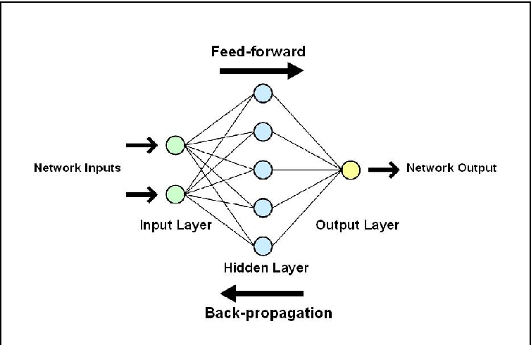
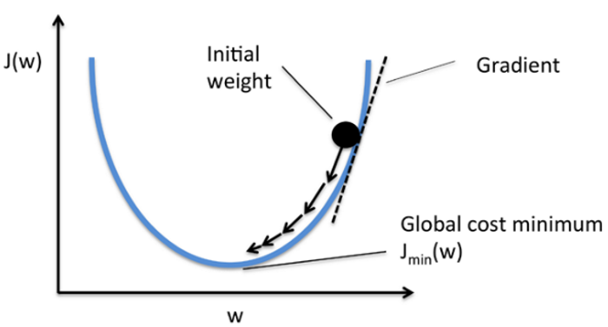
Background : DNN Training
The training process of CNN could be divided into four steps:
Feed-Forward ( FF )
Backpropagation (BP)
Weight Gradient Calculation
Weight update
The data will divided into two part : training data and inference data.
Notes:
Lets introduce DNN training.
DNN is an algorithm in machine learning.
Need to get them a lot of data to calculate the weight of this module.
Generally, the data will be randomly divided into two class for training and inference.
Training data is used to adjust the random weight to the correct weight.
Inference data will not be used to adjust the weight, They are used to tell you how accurate this set of data is.
We can divided into four major steps of DNN training.
FF, use input to get output through the original weight.
Follow the left picture, look from left input to right output.
BP, use output that calculate from FF step to get the error of the previous layer.
Still follow the left picture, but look from right output to left input.
Weight Gradient Calculation, use the error that calculate from BP step to get the error of the weight.
Follow the right picture, we will get the gradient and adjust it to minimum cost.
If the weight achieve the minimum cost, it is that we want to get.
Weight update, use the weight error that calculate from Weight Gradient Calculation to adjust the new weight.

Slide 6
Background : Compute-in-Memory
Why use CIM structure?
Use MAC in both DNN inference and training that access memory and compute memory.
Use CIM can solve the problem of weight movement.
CIM Proposed at present just support DNN inference.
Why don’t use parallel access?
Due to the increased parallelism and reduced data movement, CIM is expected to significantly improve the throughput and energy efficiency.
Because of the limited precision of ADCs and their variations, inference accuracy will degrade.
Regular memory can parallel analog read-out
with the low-throughput and low-energy-efficiency in transpose situation.
Why select SRAM?
To modify the SRAM bit-cell and periphery circuit can enable the parallel access.
Example : expanded 6T cells into 8T to support bitwise XNOR.
Sense amplifier (SA) is also replaced by ADC to produce quantized output.
CIM base on SRAM can multi-bit inference
Propose transpose CIM base on SRAM for multi-bit precision DNN.
Notes:
Then , introduce the CIM structure.
CIM can use MAC calculation and solve the problem of weight movement.
But CIM proposed at present just support DNN inference.
if CIM use parallel access, it will improve the throughput and energy efficiency.
But regular memory can get low-throughput in parallel transpose situation.
So, we use SRAM for CIM to solve parallel problem.
Just modify the SRAM bit-cell and periphery circuit can enable the parallel access.
CIM base on SRAM can multi-bit inference.
Then, they propose transpose CIM base on SRAM for multi-bit precision DNN.

Slide 7
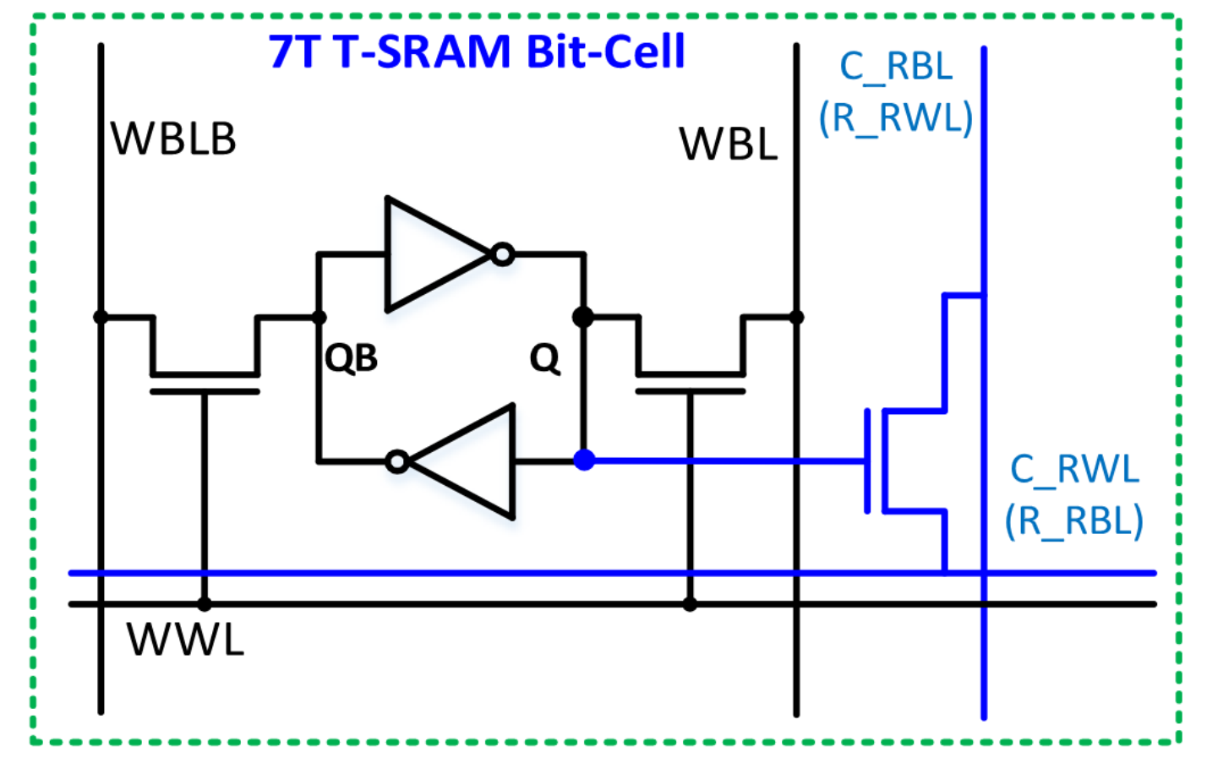
Hardware Support : 7T transpose SRAM bit cell design
Advantage : 1. small cell area overhead
2. bi-directional overhead
3. read-disturb-free-access
black line in the picture : The regular 6T cell is used for the data storage and row-by-row write
blue line in the picture : on the additional transistor (in blue color) for bi-directional read access.
Notes:
SRAM is composed of six transistors, also known as 6T SRAM.
7T transpose SRAM is an improved version of 6T SRAM.
The advantage of 7T are small cell area overhead, bi-directional overhead and read-disturb-free-access.
In the picture, the black line is a part of 6T cell.
the blue line is a additional transistor.

Slide 8
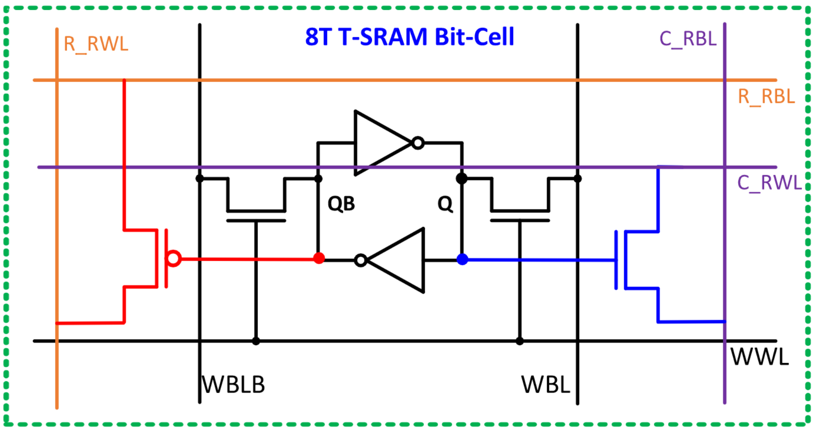
Hardware Support : 8T transpose SRAM bit cell design
Different with 7T : 1. 7T can bi-direction read access to support both FF and BP,
but 8T can access in same cell.
2. add PMOS transistor(to implement bi-directional)
3. FF and BP have separate wordline, bit-line, strong point for read access.
red line in the picture : add PMOS transistor
Notes:
8T is also like the name of 6T, have 8 transistors.
8T has two different part with 7T.
One is that 7T can bi-direction read access to support both FF and BP, but it can not access in same cell.
8T overcomes this problem.
FF and BP have separate wordline, bit-line, strong point for read access.
Two is that 8T add PMOS transistor to implement bi-directional.
Red line in the picture : add PMOS transistor
In the picture, the red line is a additional PMOS transistor.

Slide 9
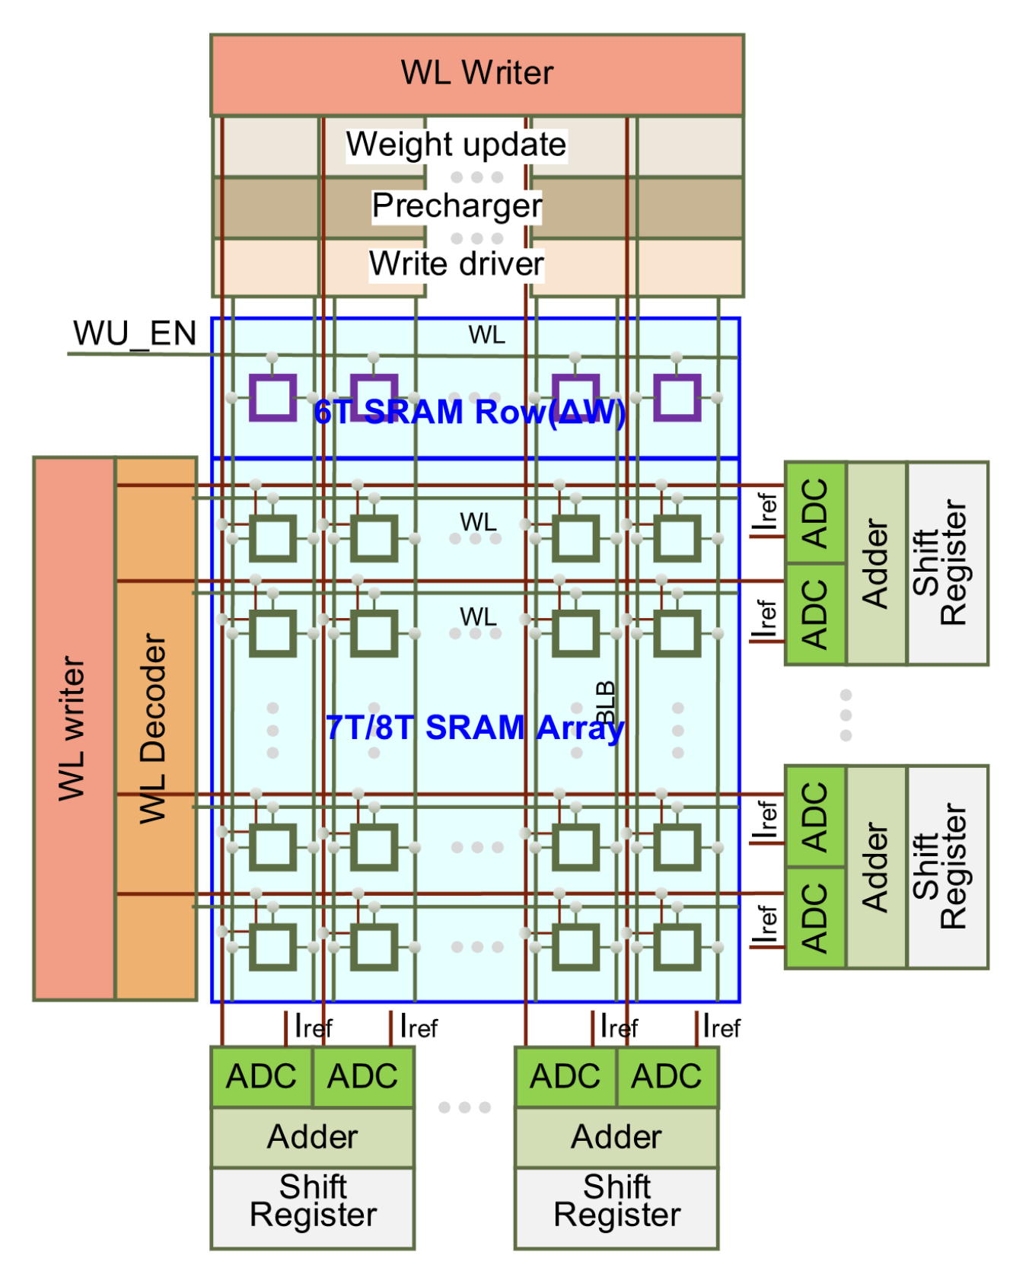
Hardware Support : Periphery Circuit
Included : 1. word line(WL) writer[with row and column access]. 2. WL decoders [weight write and per-charge circuit].
3. flash-ADC [to quantize the partial sum].
4. Shift and Adder [accumulates digitalized partial sum ].
5. 6T-SRAM Row is use for weight update.
flash-ADC, Shift, and adder support di-directional access.
Notes:
In the periphery Circuit, it includes WL writer with row and column access, WL decoder, flash-ADC, shift , adder, 6T-SRAM Row.
And flash-ADC, shift, adder are use for support di-directional access.

Slide 10
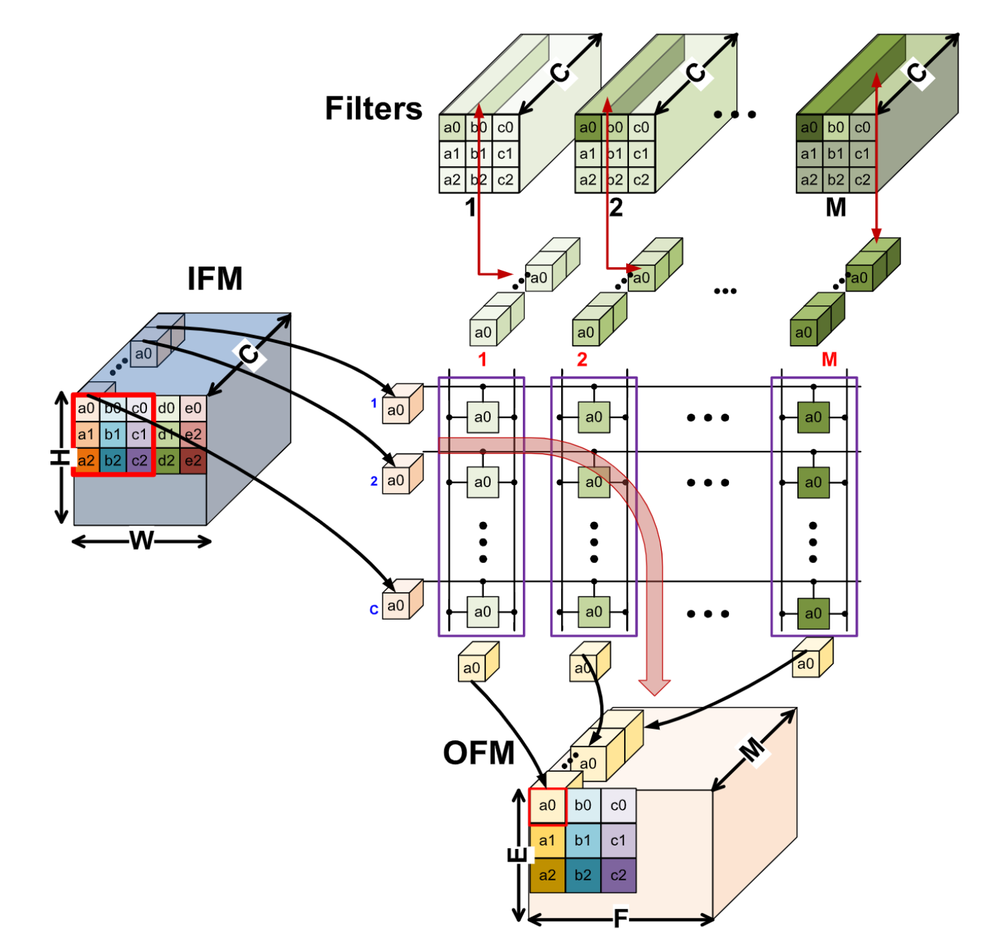
CIMAT architecture : Feed-Forward ( FF )
C is the number of filter channel / IFM(input feature map )
M is the number of filters / OFM(out feature map) channels
H/W is the IFM plane height/width
E/F is the OFM plane height/width.
Step1.
Put each element in a filter to the same column in a subarray
Step2.
Use different PEs for different locations of the elements
Step3.
Sum up the partial sums from different PEs through an adder tree
For FF,
the product of input sliding window with the same filter across
all the channels is summed up to generate one output,
which means all dot products in same column of the PE is summed up.
Notes:
This is a main architecture in this paper. Its name is CIMAT architecture.
It can divide into four part.
In FF, we can see the right picture.
C is the number of filter channel, also is the number of input feature map.
M is the number of filters, is also the number of OFM channels.
H/W and E/F are the IFM and OFM plane height/width.
Step one, we will put each element in a filter to the same column in a subarray.
Example, put a0 of the IFM to the same column.
Step two, we will use different PEs for different locations of the elements.
Example, put the filter1 to colums1 and unroll, pit filter 2 to colums2 and unroll.
Step three, we will sum up the partial sums from different PEs through an adder tree
Example, the dot of input a01 and filter a0 will add the dot of input a02 and filter a0 , and so on.
Then, we will get the OFM.

Slide 11
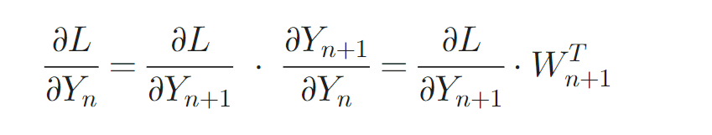
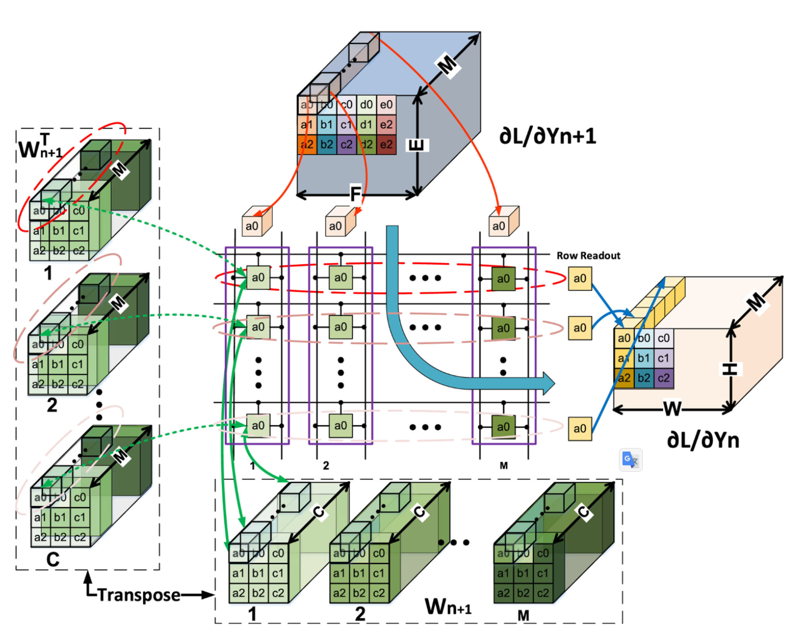
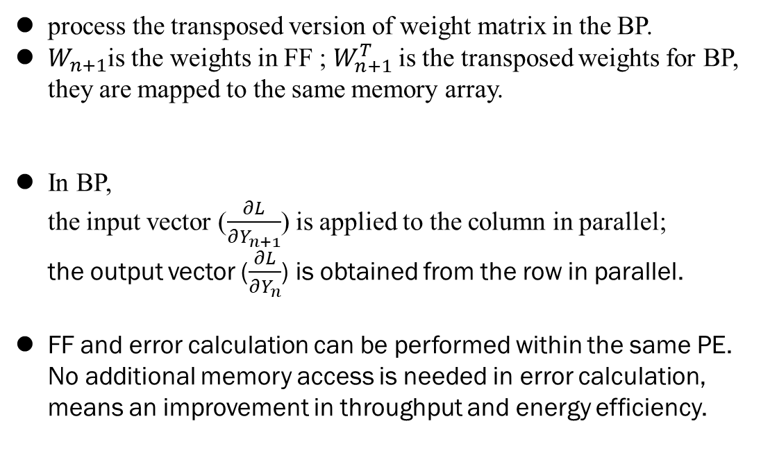
CIMAT architecture : Backpropagation ( BP )
process the transposed version of weight matrix in the BP.
$W_{n+1}$is the weights in FF ; $W_{n+1}^{T}$is the transposed weights for BP, they are mapped to the same memory array.
In BP,
the input vector ($\frac{∂L}{∂Y_{n+1}}$) is applied to the column in parallel;
the output vector ($\frac{∂L}{∂Y_{n}}$) is obtained from the row in parallel.
FF and error calculation can be performed within the same PE.
No additional memory access is needed in error calculation,
means an improvement in throughput and energy efficiency.
Notes:
In BP,
We can think of it as a reversed FF.
The formula of BP is this.
You can think the location of OFM in FF is the location of W(n+1)
So, we need to transpose W(n+1).
We will use the transpose of W(n+1) and the differential of Y(n+1) to calculate the the differential of the current layer Yn
And you can use Yn to calculate the error of weight.
FF and error calculation can be performed within the same PE.
No additional memory access is needed in error calculation, means an improvement in throughput and energy efficiency.

Slide 12
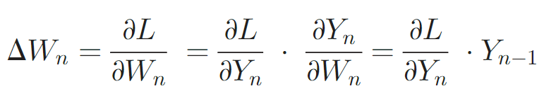
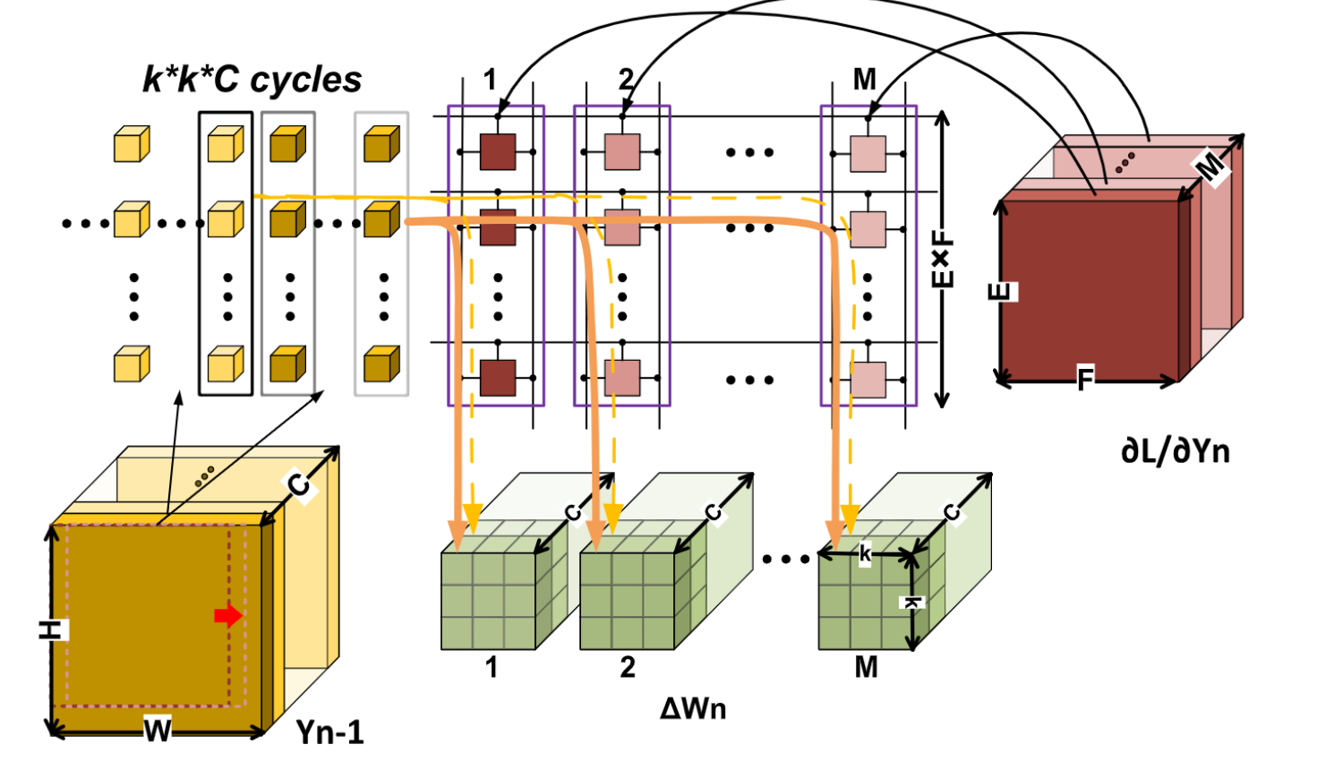
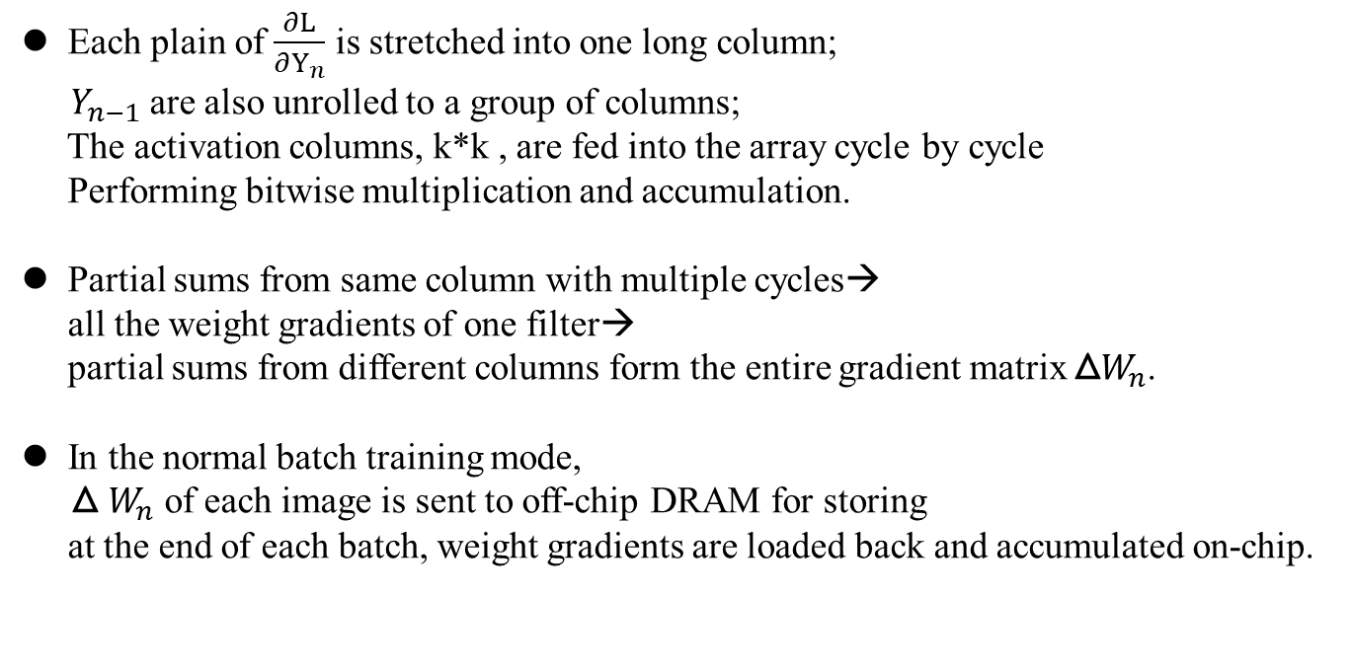
CIMAT architecture : Weight Gradient
Each plain of $\frac{∂L}{∂Y_{n}}$ is stretched into one long column;
$Y_{n−1}$are also unrolled to a group of columns;
The activation columns, k*k , are fed into the array cycle by cycle
Performing bitwise multiplication and accumulation.
Partial sums from same column with multiple cycles→
all the weight gradients of one filter→
partial sums from different columns form the entire gradient matrix Δ$W_{n}$.
In the normal batch training mode,
Δ $W_{n}$ of each image is sent to off-chip DRAM for storing
at the end of each batch, weight gradients are loaded back and accumulated on-chip.
Notes:
Each plain of the differential of Yn is stretched into one long column; Yn-1 are also unrolled to a group of columns;
The activation columns, k multiply by k , are fed into the array cycle by cycle performing bitwise multiplication and accumulation.
First, Calculate partial sums from same column with multiple cycles;
Then get all the weight gradients of one filter while partial sums from different columns form the entire gradient matrix ΔWn.(the delta)

Slide 13
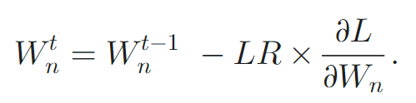
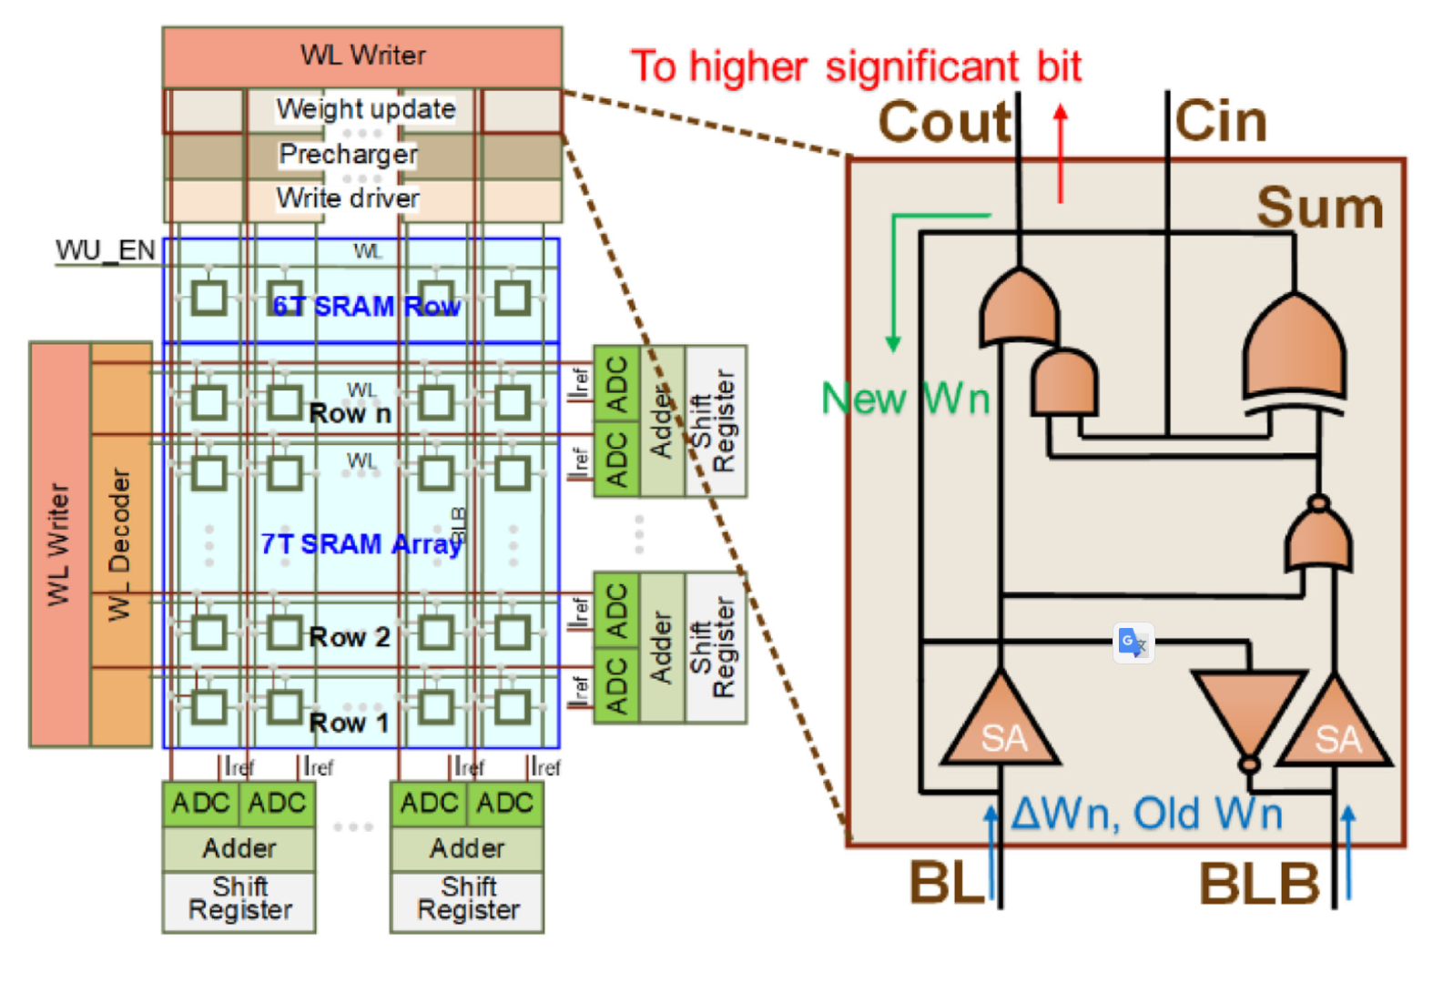
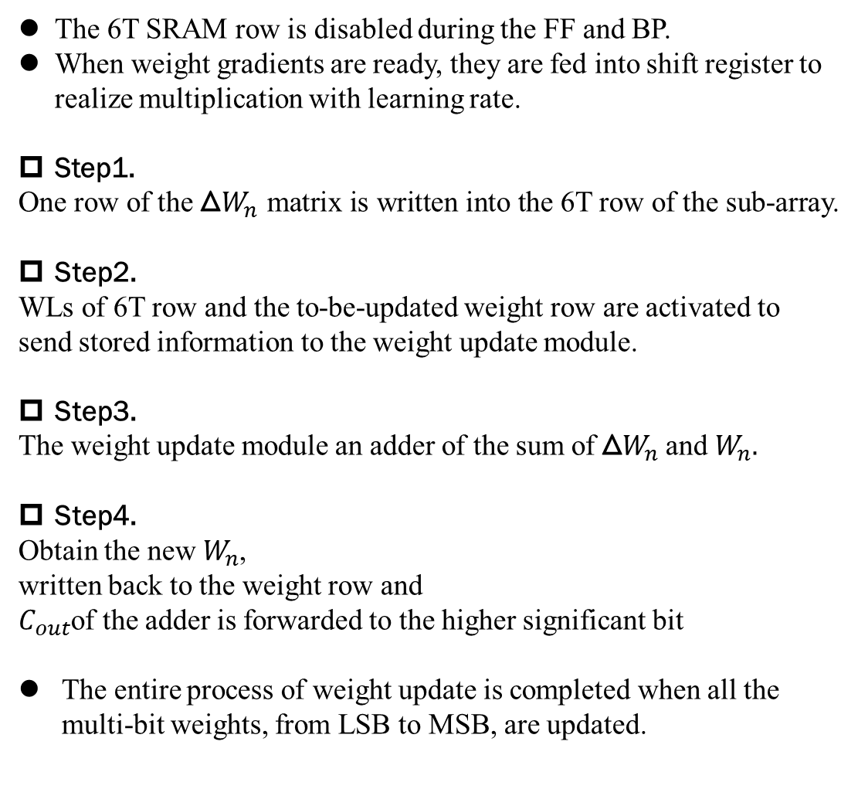
CIMAT architecture : Weight Update
The 6T SRAM row is disabled during the FF and BP.
When weight gradients are ready, they are fed into shift register to realize multiplication with learning rate.
Step1.
One row of the Δ$W_{n}$ matrix is written into the 6T row of the sub-array.
Step2.
WLs of 6T row and the to-be-updated weight row are activated to send stored information to the weight update module.
Step3.
The weight update module an adder of the sum of Δ$W_{n}$ and $W_{n}.$
Step4.
Obtain the new $W_{n}$,
written back to the weight row and
$C_{out}$of the adder is forwarded to the higher significant bit
The entire process of weight update is completed when all the multi-bit weights, from LSB to MSB, are updated.
Notes:
The last step is weight update.
The formula of weight update is this.
The 6T SRAM row is disabled during the FF and BP.
When weight gradients are ready, they are fed into shift register to realize multiplication with learning rate.
It divided four steps.
First, we write ΔWn into 6T Row SRAM.
Second, use wordlines of 6T row and the to-be-updated weight row to activate and store to the weight update module.
Third, use adder to add ΔWn and Wn.
At the end, obtain the new Wn, and write back.

Slide 14
Reported By 109598085 吳承岳

Slide 15
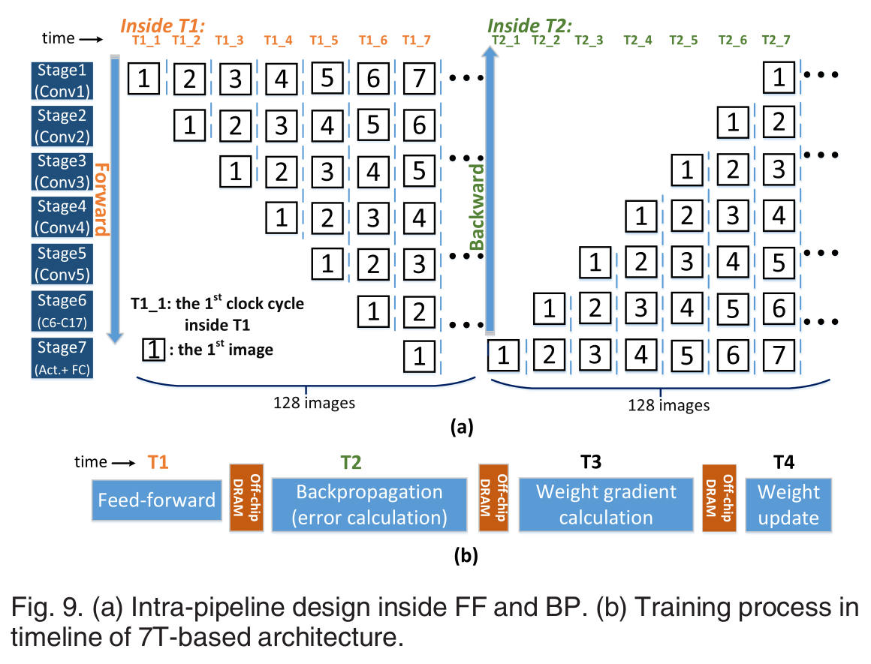
7T SRAM Bit-Cell-Based Pipeline Design
The latency of the 1st to 5th layers to process an entire image is almost the same.
Latency of 6th to 17th convolution layers is only half of the previous layers.
Fully-connected layer and other activation function circuit form stage 7.
Notes:
As an example of implementing ResNet-18, the forward pass and BP pass of error calculation are realized using 7-stage pipeline design.
Since the latency of the 1st to 5th layers to process an entire image is almost the same while the total latency of 6th to 17th convolution
layers is only half of the previous layers.
They treat the 1st to 5th layers as pipeline stage 1 to stage 5 respectively.
The 6th to 17th layers are grouped as one stage (stage 6).
Fully-connected layer and other activation function circuit form stage 7.
Fig. 9b shows the entire training process of 7T design in timeline.
Typically, 128 images form one batch.
First, for FF process, one batch of images is fed into training system stage by stage in forward direction.
After finishing FF process of one batch (T1), the error caulcation starts to operate stage by stage in backward direction (T2).
The generated intermediate data in FF and BP process needs to be saved off-chip for gradient calculation since we will obtain hundred groups of activations and errors in the batch mode, which are too large to be saved on-chip.
For gradient calculation process, after the errors are obtained for one batch, they are used togehther with the activations to calculate the gradients (to be applied to the weights) image by image (T3), which means they will get 128 groups of weight gradients after 128 runs.
Finally, the 128 groups of weight gradients are
averaged across the batch and the weights are updated in
one step using this averaged weight gradients (T4).

Slide 16
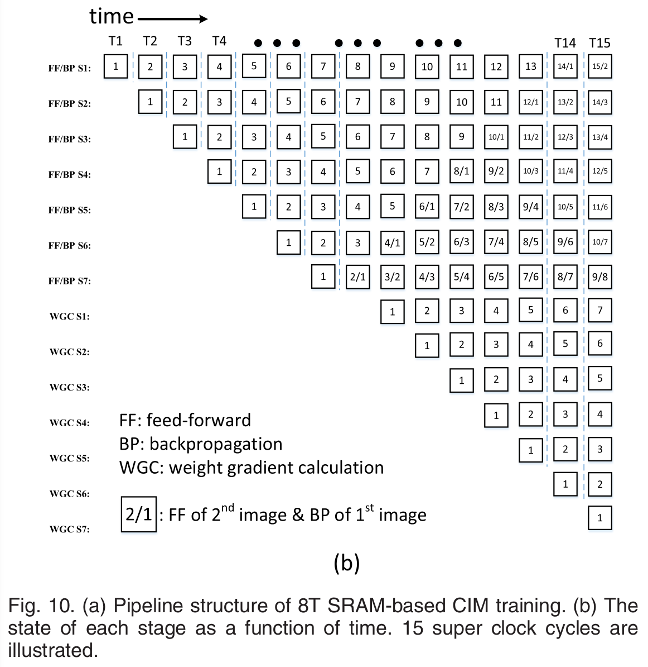
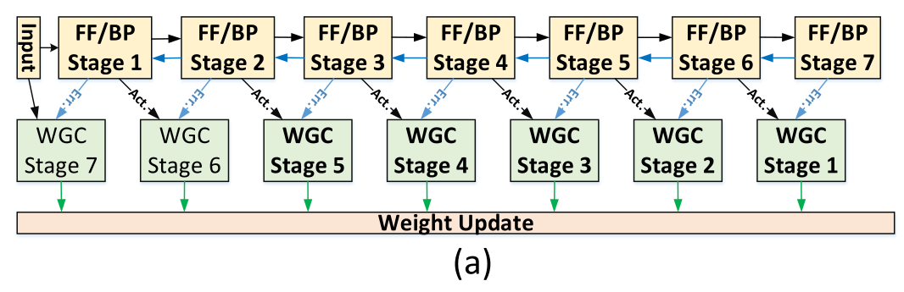
8T SRAM Bit-Cell-Based Pipeline Design
Notes:
As they mentioned before, 8T SRAM bit-cell can perform bi-directional read simultaneously, which means 8T based subarray is able to support bi-directional vector-to-matrix MAC calculation synchronously.
Thus, they optimize the pipeline design of 8T SRAM as shown in Fig. 10a.
Instead of waiting for the complete of FF process, error calculation process of 8T design could form pipelines together with FF process to increase throughput significantly.
When activation and error of the 1 st image are ready, the weight gradient calculation (WGC) could start to work.
The state of each stage as a function of time is shown in Fig. 10b.
For example, at the 9th cycle, FF/BP stage 7 is performing FF calculation of image 3 and error calculation of image 2 simutaneously.
Meanwhile, WGC stage 1 is able to calculate weight gradient for image 1 because necessary activations and error of image 1 have been obtained since the 7th cycle and the 8th cycle, respectively.

Slide 17
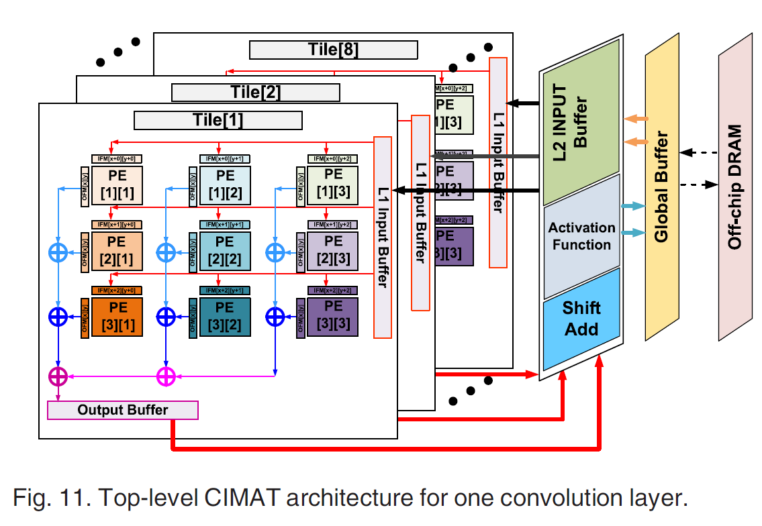
Experiments Setup
ResNet-18 model for on-chip training on ImageNet.
Use modified NeuroSim to simulate results of chip-level performance.
8-bit weight and 8-bit activations in both CIMAT and baseline settings.
The batch size for training is 128.
16 subarrays form 1 PE.
9PE forms 1 tile.(corresponding to 3 x 3 filters)
One Layer in ResNet-18 fit into 8 tiles (for 8-bit weight precision).
Notes:
They evaluate their CIMAT architecture design by implementing the ResNet-18 model for on-chip training on ImageNet.
They simulate the results of chip-level performance by using modified NeuroSim.
NeuroSim is a circuit macro model that supports flexible CIM array design options with different device technologies (from SRAM to emerging nonvolatile memories) with various peripheral circuitry modules, which has been validated with SPICE simulations and actual device data.
As the several reference papers they mentioned, recent progresses in algorithms have proved that DNN training with 8 bits is sufficient to maintain the accuracy of for large-scale data set, thus they use 8-bit weight and 8-bit activations in both CIMAT and baseline settings.
The batch size for training is 128, which means 128 images go through the FF/BP operations and the averaged weight gradients after 128 runs are used to update after the entire batch.
The typical weight matrix size of one PE in ResNet-18 could be several hundreds up to thousands, but they use matrix partition technique and limit the subarray size to 128 x 128 considering the practical maximum SRAM array size when accessed in parallel.
Hence, 16 subarrays are formed into one PE and 9 PEs (corresponding to 3 x 3 filters) are formed into one tile, which means any layer in ResNet-18 can fit into 8 tiles (for 8-bit weight precision).
To simplify periphery circuit of transposable subarray, weight bits with different significance are stored on different tiles (i.e., 8 tiles) with shift-add to combine them together after obtaining their partial sums.
Like Fig. 11, a layer contains 8 tiles, shift-add units, activation function units, L2 buffer and the global buffer.
A tile contains multiple PEs, adder trees and L1 buffer.
In both FF and BP, the multi-bit inputs are sent to the weight arrays from LSB to MSB using eight cycles and the output are accumulated with shift-add calculation.
Then the adder trees accumulate results for all the subarrays in one PE for one element of the filter.
Accumulated results from PEs in the same tile accumulate again through adder trees outside PE to finish bitwise MAC for the entire filter, but only for single significance of the weight.
Outside tiles, shift-add will be performed again for eight tiles to obtain the eventual 8-bit output of OFM.

Slide 18
Baseline
Use the regular 6T SRAM arrays to store weights and do near-memory computation.(i.e. row-by-row read-out with digital adders at the edge of the array to accumulate the partial sum).
Since non-transpose SRAM is used, each time when they read out a row, they obtain all the elements for one transpose filter.
They use a group of 8-bit multipliers to get the products of the filter elements and the inputs.
For weight gradient calculation, the FF activations of each layer are fetched from off-chip DRAM and then multipliers and adder trees are used to realize bitwise matrix-to-matrix multiplication and accumulation of the activation and error.
All the weight gradients will be stored off-chip for weight update.
Finally, weights for batch inputs are accumulated by adders and new weights are calculated by digital circuits and then written back to 6T SRAM arrays.
Notes:
Baseline is like the control group they want to compare to.
For the baseline, They use the regular 6T SRAM arrays to store weights and do near-memory computation (i.e., row-by-row read-out with digital adders at the edge of the array to accumulate the partial sum).
For the BP, since non-transpose SRAM is used, each time when they read out a row, they obtain all the elements for one transpose filter.
Then a group of 8-bit multipliers is used to get the products of the filter elements and the inputs.
The FF activations of each layer are first fetched from off-chip DRAM and then multipliers and adder trees are used to realize bitwise matrix-to-matrix multiplication and accumulation of the activation and error.
All the weight gradients will be stored off-chip for weight update.
Finally, weights for batch inputs are accumulated by adders and new weights are calculated by digital circuits and then written back to 6T SRAM arrays.
They propose this near-memory computation solution as baseline to verify the advantages of CIM approach.

Slide 19
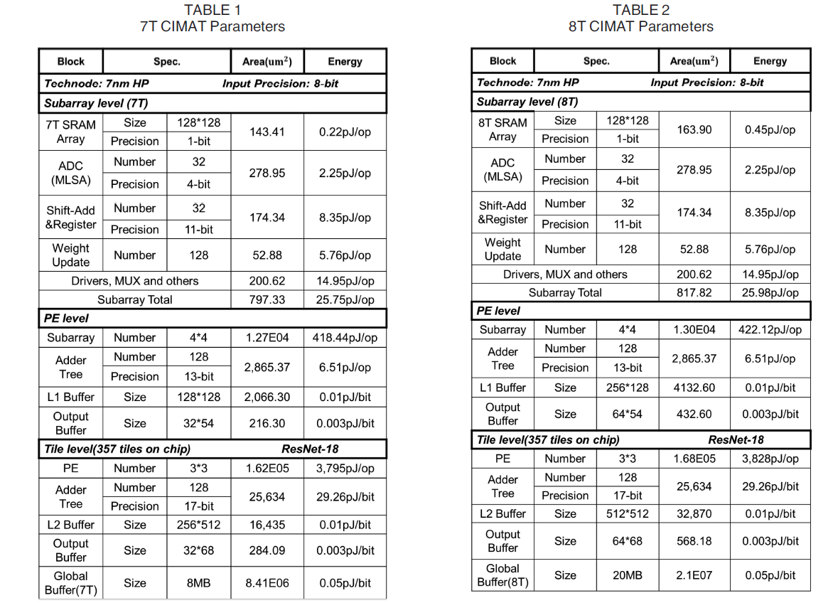
Circuit-Level Parameter
Notes:
We model the CIMAT design according to state-of-the-art 7 nm high performance (HP) CMOS library and build the CIMAT architecture with a modified NeuroSim framework by adding the considerations of the on-chip buffer and off-chip DRAM access.
Table 1 shows circuit-level parameters based on 7T SRAM design, including the hardware configuration, precision, area and energy for key circuit modules.
As we see here, the SRAM array area of 8T is larger than 7T.
Since the bi-direction read, 8T need more space to store the data, so the L1 Buffer, output buffer, L2 Buffer, Global Buffer of 8T are twice as 7T.

Slide 20
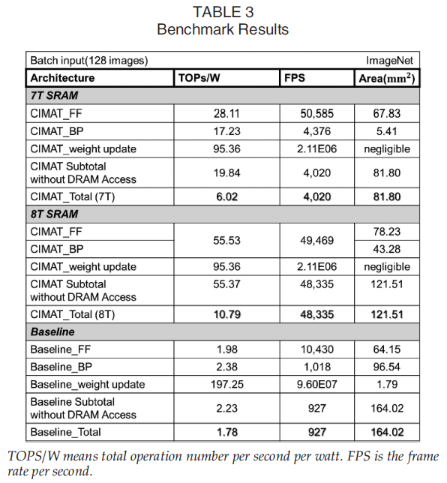
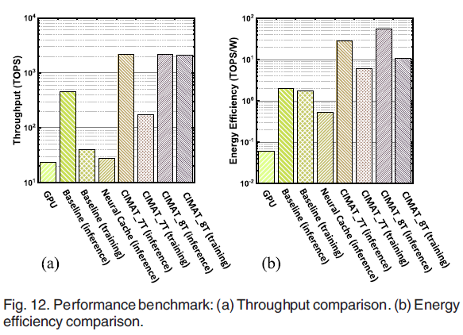
Benchmark Evaluation
Notes:
They compare the proposed CIMAT architectures with a baseline design with regular 6T SRAM array with row-by-row read.
This table shows the comparison of performance between 7T/8T SRAM based architecture and the baseline.
The batch size for training is fixed to 128 ImageNet images per batch.
The energy efficiency in terms of TOPS/W, the frame rate in terms of FPS and the
chip area are evaluated for FF, BP and weight update, respectively.
Here, BP performance includes both error calculation and gradient calculation.
As we see here, energy efficiency of CIMAT for both FF and BP process is much improved over that of baseline.
Besides, with the transpose SRAM design, area for BP process is much smaller than baseline due to shared CIM arrays and elimination of additional digital circuit for error calculation.
Compared to near-memory computation baseline, 7T SRAM based CIMAT training architecture can achieve overall
4.34 speed up and 3.38 improvement in energy efficiency with 0.5 chip area
8T based CIMAT can further increase energy efficiency and throughput with 0.74 chip area.
Figure 12 compares the performance and energy efficiency of CIMAT with the GPU-based implementation, proposed near-memory computation baseline and Neural Cache which is a state-of-the-art hardware accelerating DNN inference using SRAM-based in-memory computing architecture.
For GPU platform, the experiments are performed using Pytorch running on NVidia Titan RTX.
They use NVidia-SMI tool for GPU power measurement.
For Neural Cache, we used 28 TOPS and 52.92W average power at 22nm technology.
Their evaluation shows that CIMAT 7T design can achieve on average 7.4 speedup and 100 energy efficiency in
training as compared to GPU-based approach.
Compared to Neural Cache, CIMAT provides 78.7 speedup and 53x higher energy efficiency in feed-forward and could support
training instead of inference only.
They also compares CIMAT training performance over inference with 7T and 8T structure.
For throughput, 8T design could provides almost same speed for both inference and training while the training speed of 7T design is limited to less than 1/10 of inference.
The higher throughput of 8T design comes from the inter-pipeline between training processes as shown before.

Slide 21
CONCLUSION
They focus on ResNet-18 impelementation in this work, but our proposed methodologies could be applied to implement other DNN models.
The experiment results show that, 7T SRAM based CIMAT can achieve 3.38 higher energy efficiency (6.02 TOPS/W), 4.34 frame rate (4,020 fps) and only 50 percent chip size architecture with conventional 6T SRAM array that supports row-by-row read only.
8T SRAM based CIMAT can achieves more energy saving (10.79 TOPS/W) and aggressively more than 10 throughput (48,335 fps) with tolerable area overhead (121.51 mm 2 ) compared to 7T CIMAT.
Their results reveal that CIM is a promising solution to implement on-chip DNN training, which can reduce off-chip talk significantly.
CIM approach is more attractive to edge device due to much improved energy efficiency. From the algorithm’s perspective, there are many efforts on developing small networks for edge AI application.
Notes:
Q&A?

